Slide 1
Introduction to Advanced Databases

Slide 2
What is Database?
A database is a collection of related data which represents some elements of the real world. It is designed to be built and populated with data for a specific task. It is also a building block of your data solution.

Slide 3
What is a Data Warehouse?
A data warehouse is an information system which stores historical and commutative data from single or multiple sources. It is designed to analyze, report, integrate transaction data from different sources.
Data Warehouse eases the analysis and reporting process of an organization. It is also a single version of truth for the organization for decision making and forecasting process.

Slide 4
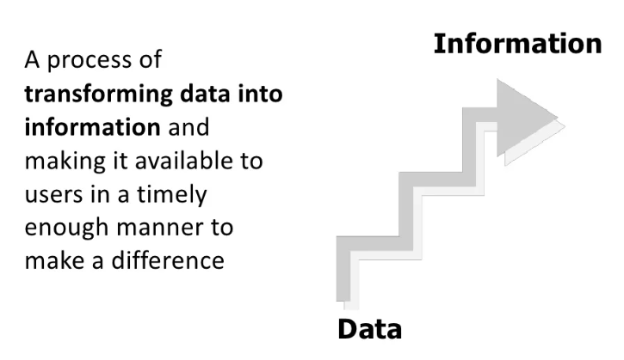

Slide 5
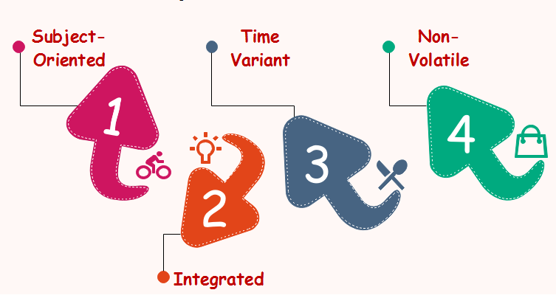

Slide 6
Why Use Data Warehouse?
helps business users to access critical data from some sources all in one place.
consistent information on various cross-functional activities
Helps you to integrate many sources of data to reduce stress on the production system.
Data warehouse helps you to reduce TAT (total turnaround time) for analysis and reporting.
Data warehouse helps users to access critical data from different sources in a single place so, it saves user’s time of retrieving data information from multiple sources. You can also access data from the cloud easily.

Slide 7
Continue…
Data warehouse allows you to store a large amount of historical data to analyze different periods and trends to make future predictions.
Enhances the value of operational business applications and customer relationship management systems
Separates analytics processing from transactional databases, improving the performance of both systems
Stakeholders and users may be overestimating the quality of data in the source systems. Data warehouse provides more accurate reports.

Slide 8
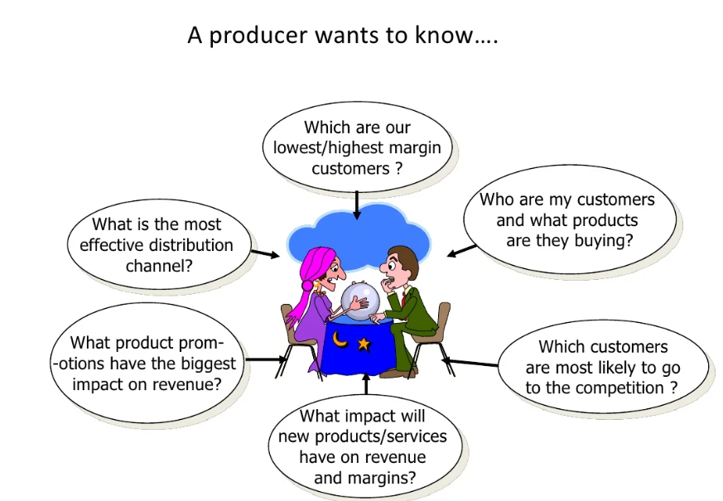

Slide 9
Example Applications of Data Warehousing
Social Media Websites
Banking
Government
E-Commerce
Telecommunications
Transportation Services
Marketing and Distribution
Healthcare
Retail…

Slide 10
Warehouse tools
Amazon Redshift-Amazon Redshift is a cloud-based fully managed petabytes-scale data warehouse
Microsoft Azure
Google BigQuery: BigQuery is a serverless data warehouse that allows scalable analysis over petabytes of data
Snowflake: Snowflake is a cloud computing-based data warehousing built on top of the Amazon Web Services or Microsoft Azure cloud infrastructure.
Micro Focus Vertica
Amazon DynamoDB: fully managed proprietary NoSQL data warehouse service that supports key-value and document data structures
PostgreSQL
Amazon S3
Cloudera…

Slide 11
Multimedia Database
A Multimedia database is a special type of database that helps us to organize, query, and store inter-related multimedia data.
It facilitates the storage and retrieval of multimedia data elements. In these databases, all the media files are stored in the form of binary strings and are encoded according to their file types. Let's look at different types of multimedia databases.

Slide 12
Types of Multimedia Database
Static media: These multimedia datasets are specifically used for static media objects i.e., those objects which are independent of the time constraints such as images and graphic objects.
Dynamic media: These datasets are used to store dynamic forms of media content i.e. those multimedia data elements which are time-dependent like audio data, video data, and animations.
Dimensional media: Dimensional multimedia datasets are typically used in Computer-Aided Drafting programs. These operate on 3D multimedia data and include various formats used by the image and video editing applications.

Slide 13
Content of Multimedia Database
To effectively manage and query a large collection of multimedia data, multimedia databases also store additional information related to the data apart from the primary multimedia data. The contents of a multimedia database are:
Media data: It is the actual multimedia data or the primary data stored in the multimedia database. It represents a multimedia object and can be an image, audio, video, animation, graphic object, or text.
Media format data: It is the information related to the format of the multimedia data. It contains data such as sampling rate, resolution, encoding scheme etc. about the format of the media data after it goes through the acquisition, processing and encoding phase.
Media keyword data: It is also knowns as content descriptive data and contains the information related to the generation of multimedia data like date and time in case of images and videos, etc.
Media feature data: It is used to describe the features of multimedia data such as the distribution of colors, kinds of texture and different shapes present in data etc.

Slide 14
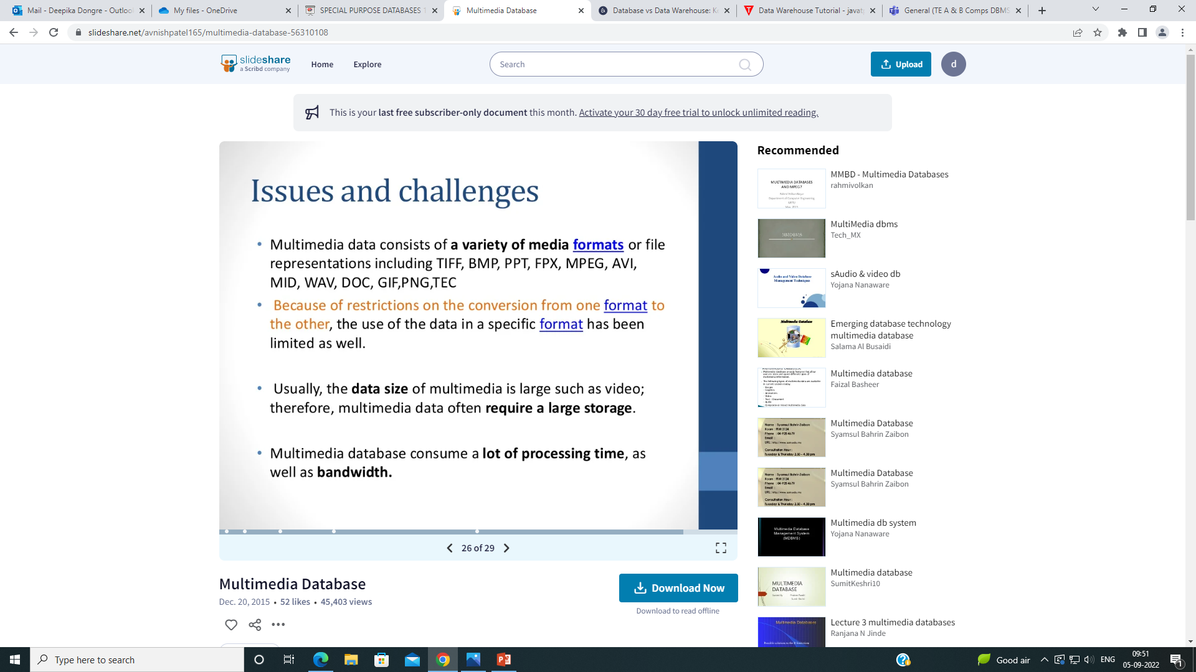
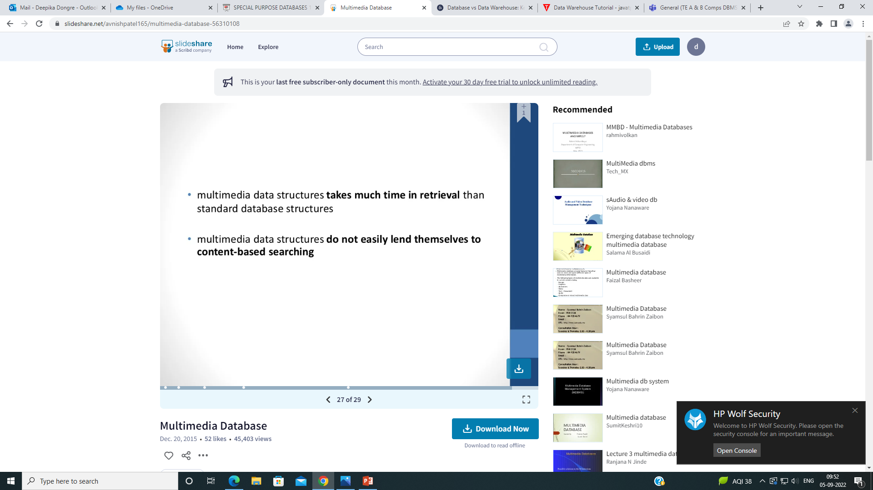
Issues & Challenges

Slide 15
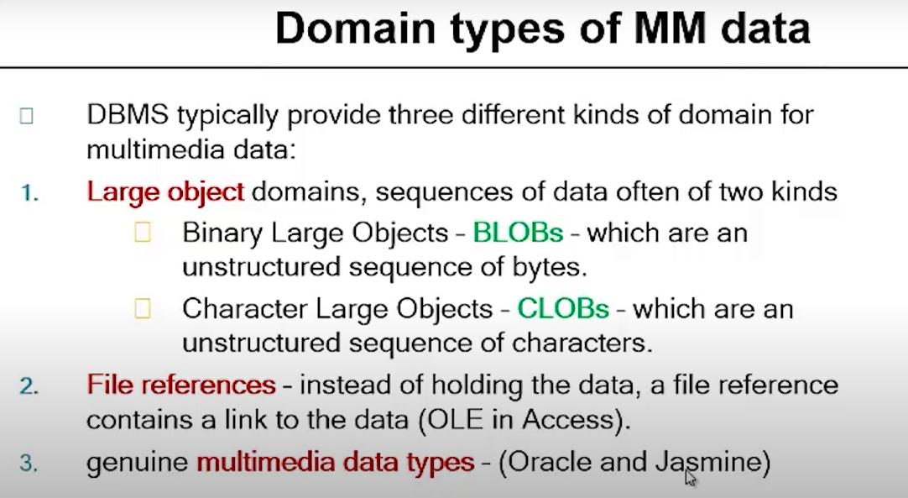

Slide 16
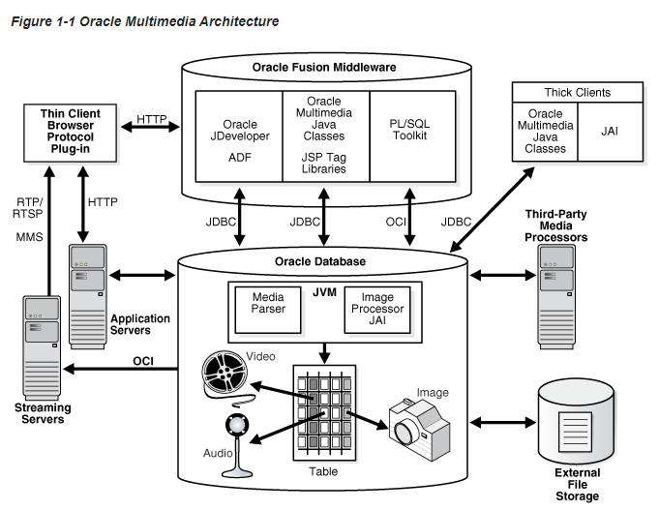

Slide 17
Applications
Documents and record management: Industries which keep a lot of documentation and records. Ex: Insurance claim industry.
Knowledge dissemination: Multimedia database is an extremely efficient tool for knowledge dissemination and providing several resources. Ex: electronic books
Education and training: Multimedia sources can be used to create resources useful in education and training. These are popular sources of learning in recent days. Ex: Digital libraries.
Real-time monitoring and control: Multimedia presentation when coupled with active database technology can be an effective means for controlling and monitoring complex tasks. Ex: Manufacture control
Marketing
Advertisement
Retailing
Entertainment
Travel

Slide 18
Mobile Database
Mobile databases are separate from the main database and can easily be transported to various places. Even though they are not connected to the main database, they can still communicate with the database to share and exchange data.
The mobile database includes the following components −
The main system database that stores all the data and is linked to the mobile database.
The mobile database that allows users to view information even while on the move. It shares information with the main database.
The device that uses the mobile database to access data. This device can be a mobile phone, laptop etc.
A communication link that allows the transfer of data between the mobile database and the main database.

Slide 19
Mobile Database typically involves three parties :
Fixed Hosts – It performs the transactions and data management functions with the help of database servers.
Mobiles Units – These are portable computers that move around a geographical region that includes the cellular network that these units use to communicate to base stations.
Base Stations – These are two-way radios installation in fixed locations, that pass communication with the mobile units to and from the fixed hosts.

Slide 20
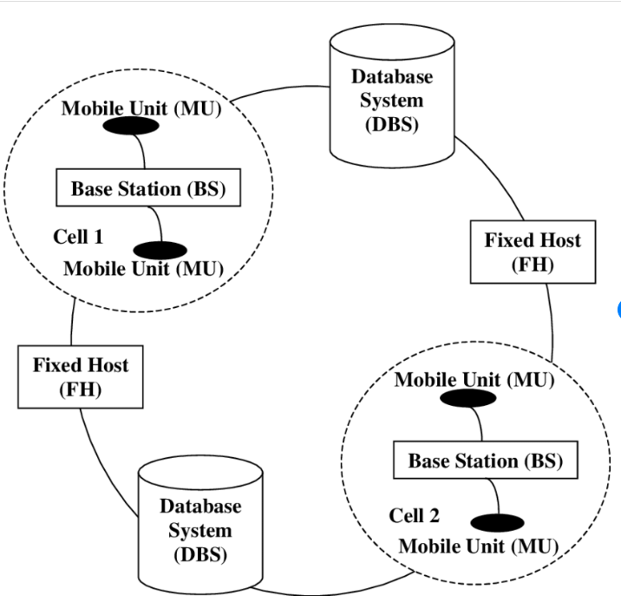

Slide 21
Limitations
Here, we will discuss the limitation of mobile databases as follows.
It has Limited wireless bandwidth.
In the mobile database, Wireless communication speed.
It required Unlimited battery power to access.
It is Less secured.
It is Hard to make theft-proof.

Slide 22
Existing mobile databases
Sybase SQL Anywhere.
Oracle lite.
Microsoft SQL server compact.
SQ lite.
IBM DB2 everyplace (DB2e).

Slide 23
No SQL?
NoSQL stands for:
No Relational
No RDBMS
Not Only SQL
NoSQL is an umbrella term for all databases and data stores that don’t follow the RDBMS principles
A class of products
A collection of several (related) concepts about data storage and manipulation
Often related to large data sets

Slide 24
Where does NoSQL come from?
Non-relational DBMSs are not new
But NoSQL represents a new incarnation
Due to massively scalable Internet applications
Based on distributed and parallel computing
Development
Starts with Google
First research paper published in 2003
Continues also thanks to Lucene's developers/Apache (Hadoop) and Amazon (Dynamo)
Then a lot of products and interests came from Facebook, Netfix, Yahoo, eBay, Hulu, IBM, and many more

Slide 25
NoSQL Distinguishing Characteristics
Large data volumes
Google’s “big data”
Scalable replication and distribution
Potentially thousands of machines
Potentially distributed around the world
Queries need to return answers quickly
Mostly query, few updates
Asynchronous Inserts & Updates
Schema-less
ACID transaction properties are not needed – BASE
CAP Theorem
Open source development

Slide 26
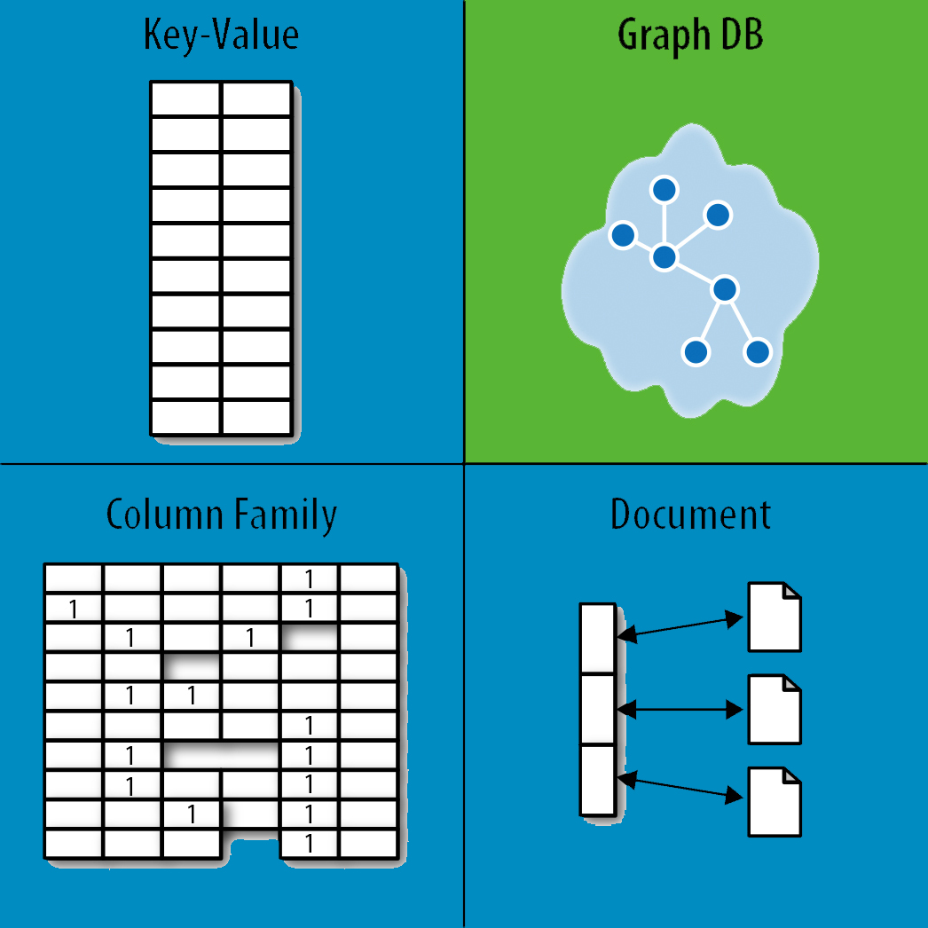
NoSQL Database Types
Discussing NoSQL databases is complicated because there are a variety of types:
Sorted ordered Column Store
Optimized for queries over large datasets, and store columns of data together, instead of rows
Apache Cassandra, Apache HBase
Key-Value Store :
are the simplest NoSQL databases. Every single item in the database is stored as an attribute name (or 'key'), together with its value.
Redis, Riak, and Oracle NoSQL
Document databases:
pair each key with a complex data structure known as a document.
MongoDB, DynamoDB and CosmosDB,couchbase
Graph Databases :
are used to store information about networks of data, such as social connections.

Slide 27
XML Database
XML Database is used to store huge amount of information in the XML format. As the use of XML is increasing in every field, it is required to have a secured place to store the XML documents. The data stored in the database can be queried using XQuery, serialized, and exported into a desired format.
XML Database Types
There are two major types of XML databases −
XML- enabled
Native XML (NXD)

Slide 28
XML - Enabled Database
XML enabled database is nothing but the extension provided for the conversion of XML document. This is a relational database, where data is stored in tables consisting of rows and columns. The tables contain set of records, which in turn consist of fields.

Slide 29
Native XML Database
Native XML database is based on the container rather than table format. It can store large amount of XML document and data. Native XML database is queried by the XPath-expressions.
Native XML database has an advantage over the XML-enabled database. It is highly capable to store, query and maintain the XML document than XML-enabled database.

Slide 30
<?xml version = "1.0"?>
<contact-info>
<contact1>
<name>Tanmay Patil</name>
<company>TutorialsPoint</company>
<phone>(011) 123-4567</phone>
</contact1>
<contact2>
<name>Manisha Patil</name>
<company>TutorialsPoint</company>
<phone>(011) 789-4567</phone>
</contact2>
</contact-info>

Slide 31
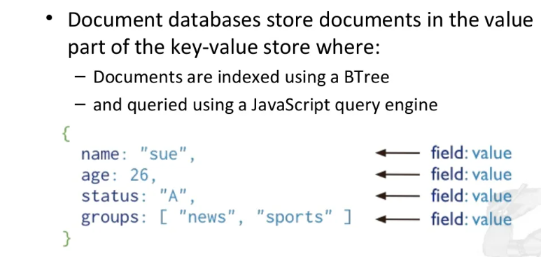
What is document DB

Slide 32
What are documents?
A document is a record in a document database. A document typically stores information about one object and any of its related metadata.
Documents store data in field-value pairs. The values can be a variety of types and structures, including strings, numbers, dates, arrays, or objects. Documents can be stored in formats like JSON, BSON, and XML.

Slide 33
What are the key features of document databases?
Document databases have the following key features:
Document model: Data is stored in documents (unlike other databases that store data in structures like tables or graphs). Documents map to objects in most popular programming languages, which allows developers to rapidly develop their applications.
Flexible schema: Document databases have a flexible schema, meaning that not all documents in a collection need to have the same fields. Note that some document databases support schema validation, so the schema can be optionally locked down.
Distributed and resilient: Document databases are distributed, which allows for horizontal scaling (typically cheaper than vertical scaling) and data distribution. Document databases provide resiliency through replication.
Querying through an API or query language: Document databases have an API or query language that allows developers to execute the CRUD operations on the database. Developers have the ability to query for documents based on unique identifiers or field values.

Slide 34
What are the relationships between document databases and other databases?
The document model is a superset of other data models, including key-value pairs, relational, objects, graph, and geospatial.
Key-value pairs can be modeled with fields and values in a document. Any field in a document can be indexed, providing developers with additional flexibility in how to query the data.
Relational data can be modeled differently (and some would argue more intuitively) by keeping related data together in a single document using embedded documents and arrays. Related data can also be stored in separate documents, and database references can be used to connect the related data.
Documents map to objects in most popular programming languages.
Graph nodes and/or edges can be modeled as documents. Edges can also be modeled through database references. Graph queries can be run using operations like $graphLookup.
Geospatial data can be modeled as arrays in documents.

Slide 35
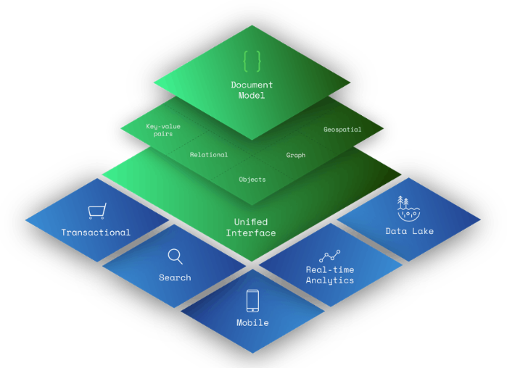

Slide 36
Applications:
Customer data management and personalization
Internet of Things (IoT) and time-series data
Product catalogs and content management
Payment processing
Mobile apps
Mainframe offload
Operational analytics
Real-time analytics

Slide 37
Graph databases
A graph database stores nodes and relationships instead of tables, or documents. Data is stored just like you might sketch ideas on a whiteboard. Your data is stored without restricting it to a pre-defined model, allowing a very flexible way of thinking about and using it.
Graph databases address big challenges many of us tackle daily. Modern data problems often involve many-to-many relationships with heterogeneous data that sets up needs to:
Navigate deep hierarchies,
Find hidden connections between distant items, and
Discover inter-relationships between items.
Whether it’s a social network, payment networks, or road network you’ll find that everything is an interconnected graph of relationships. And when we want to ask questions about the real world, many questions are about the relationships rather than about the individual data elements.

Slide 38
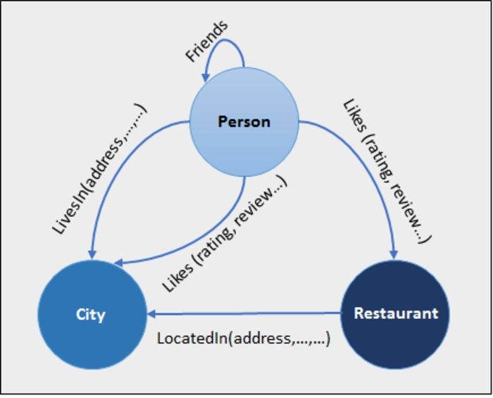
The Node: This is the actual piece of data itself. It can be the number of viewers of a youtube video, the number of people who have read a tweet, or it could even be basic information such as people’s names, addresses, and so forth.
The Edge: This explains the actual relationship between two nodes. Interestingly enough, edges can also have their own pieces of information, such as the nature of the relation between two nodes. Similarly, edges might also have directions describing the flow of said data.

Slide 39
Nodes are the entities in the graph.
Nodes can be tagged with labels, representing their different roles in your domain. (For example, Person).
Nodes can hold any number of key-value pairs, or properties. (For example, name)
Node labels may also attach metadata (such as index or constraint information) to certain nodes.
Relationships provide directed, named, connections between two node entities (e.g. Person LOVES Person).
Relationships always have a direction, a type, a start node, and an end node, and they can have properties, just like nodes.
Nodes can have any number or type of relationships without sacrificing performance.
Although relationships are always directed, they can be navigated efficiently in any direction.

Slide 40
Example
Neo4j
RedisGraph
OrientDB

Slide 41
Federated database system
A federated database system (FDBS) is a type of meta-database management system (DBMS), which transparently maps multiple autonomous database systems into a single federated database. The constituent databases are interconnected via a computer network and may be geographically decentralized. Since the constituent database systems remain autonomous, a federated database system is a contrastable alternative to the (sometimes daunting) task of merging several disparate databases. A federated database, or virtual database, is a composite of all constituent databases in a federated database system. There is no actual data integration in the constituent disparate databases as a result of data federation.

Slide 42
A federated system is a special type of distributed database management system (DBMS) that consists of a database instance that operates as a federated server, a database that acts as the federated database, one or more data sources, and clients (users and applications) that access the database and data sources.
A federated system serves as the foundation on which one or more data virtualization solutions can be built.
Within a federated system, a single SQL statement can access data that is distributed among several data sources. For example, a single SQL statement can join data that is located in a Db2® table, an Oracle table, and an XML tagged file. The following figure shows the components of a federated system and examples of data sources that comprise it.

Slide 43
The power of a federated system is in its ability to:
Correlate data from local tables and remote data sources, as if all the data is stored locally in a single database
Update data in relational data sources, as if the data is stored in a single database
Move data to and from relational data sources
Take advantage of data source's processing strengths, by sending requests to particular data sources for processing
Compensate for SQL limitations at a data source by having the federated server process parts of a distributed request.

Slide 44
